Slide 1
Deep Learning for Natural Language Processing
Abhirut Gupta IBM Research AI

Slide 3
What you get out of this?
What is natural language processing?
Why is it hard?
Basic building blocks

Slide 5

The Turing Test
Can machines imitate humans?
The ability to understand human (natural) language

Slide 6
What could we do with computers that understand Natural Language?
Answer our long essay questions? (10 marks)
Better Search Engines! (Ever tried Google with a 10+ word query?)
Machine Translation
Computer aided Psychotherapy
Computer Lawyers - IBM Debater (https://youtu.be/m3u-1yttrVw?t=585)

Slide 7
Why is Natural Language Hard?
I shot an Elephant wearing my pajamas.
Ambiguity

Slide 8
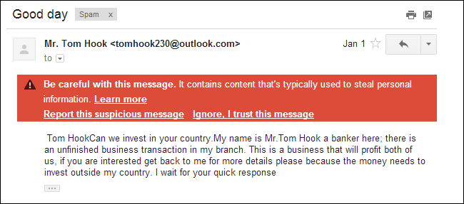
Machine Learning / Deep Learning for NLP
Sample Problem –
Does an e-mail contain SPAM?

Slide 9
Machine Learning / Deep Learning for NLP
1.1 | -1 | 0.2 | 0.7 | .. | .. | .. | .. | .. | 1.5
Class Label
Feature Vector
Model
SPAM Classification
Email
?
Spam / Not Spam
Model (Will get back to this)

Slide 10
Machine Learning / Deep Learning for NLP
Email
?
1.1 | -1 | 0.2 | 0.7 | .. | .. | .. | .. | .. | 1.5
Feature Vector
Metadata
Sender Email Address
Sender Domain
…
Content
Length of email text
Presence of certain words in subject and body – “lottery”, “money”, “transfer”
Manually come up with this list?!
What about other types of spam emails?

Slide 11
Feature Vectors from Text
Bag of Words –
“I enjoy programming”
“He likes sports”
“I don’t enjoy sports”
TF-IDF – Term Frequency – Inverse Document Frequency
Function of number of times a word appears in the text, and inverse of count in corpus
0 | 1 | 0 | 1 | 0 | 1 | 0
don’t | enjoy | he | I | likes | programming | sports
0 | 0 | 1 | 0 | 1 | 0 | 1
don’t | enjoy | he | I | likes | programming | sports
1 | 1 | 0 | 1 | 0 | 0 | 1
don’t | enjoy | he | I | likes | programming | sports

Slide 12
Feature Vectors from Text
So, Good?
Amazingly simple, and does well in many applications (SPAM filtering)
Limitations
Loses ordering of the words
No notion of “word similarity” (Dog is as similar to Cat as it is to Ship)
Word2Vec / Glove
“Dog” and “cat” appear in similar contexts and “ship” doesn’t
I took my pet dog to the vet
My pet cat is sick
My pet ship is sick?
Vector for each word that encodes the “context”

Slide 13
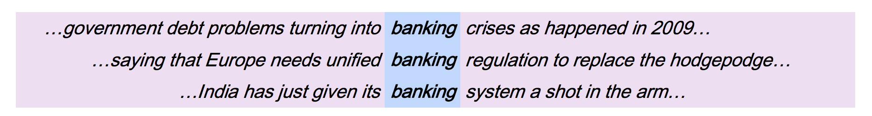
Context for each word – Naïve way
1 | 0 | 1 | 0 | 1 | 0 | 1 | 0 | 1 | 0
debt | … | crises | … | government | … | regulation | … | system

Slide 14
Word2Vec
debt
government
regulation
Predict
Neural Network
Vector for “banking”

Slide 15
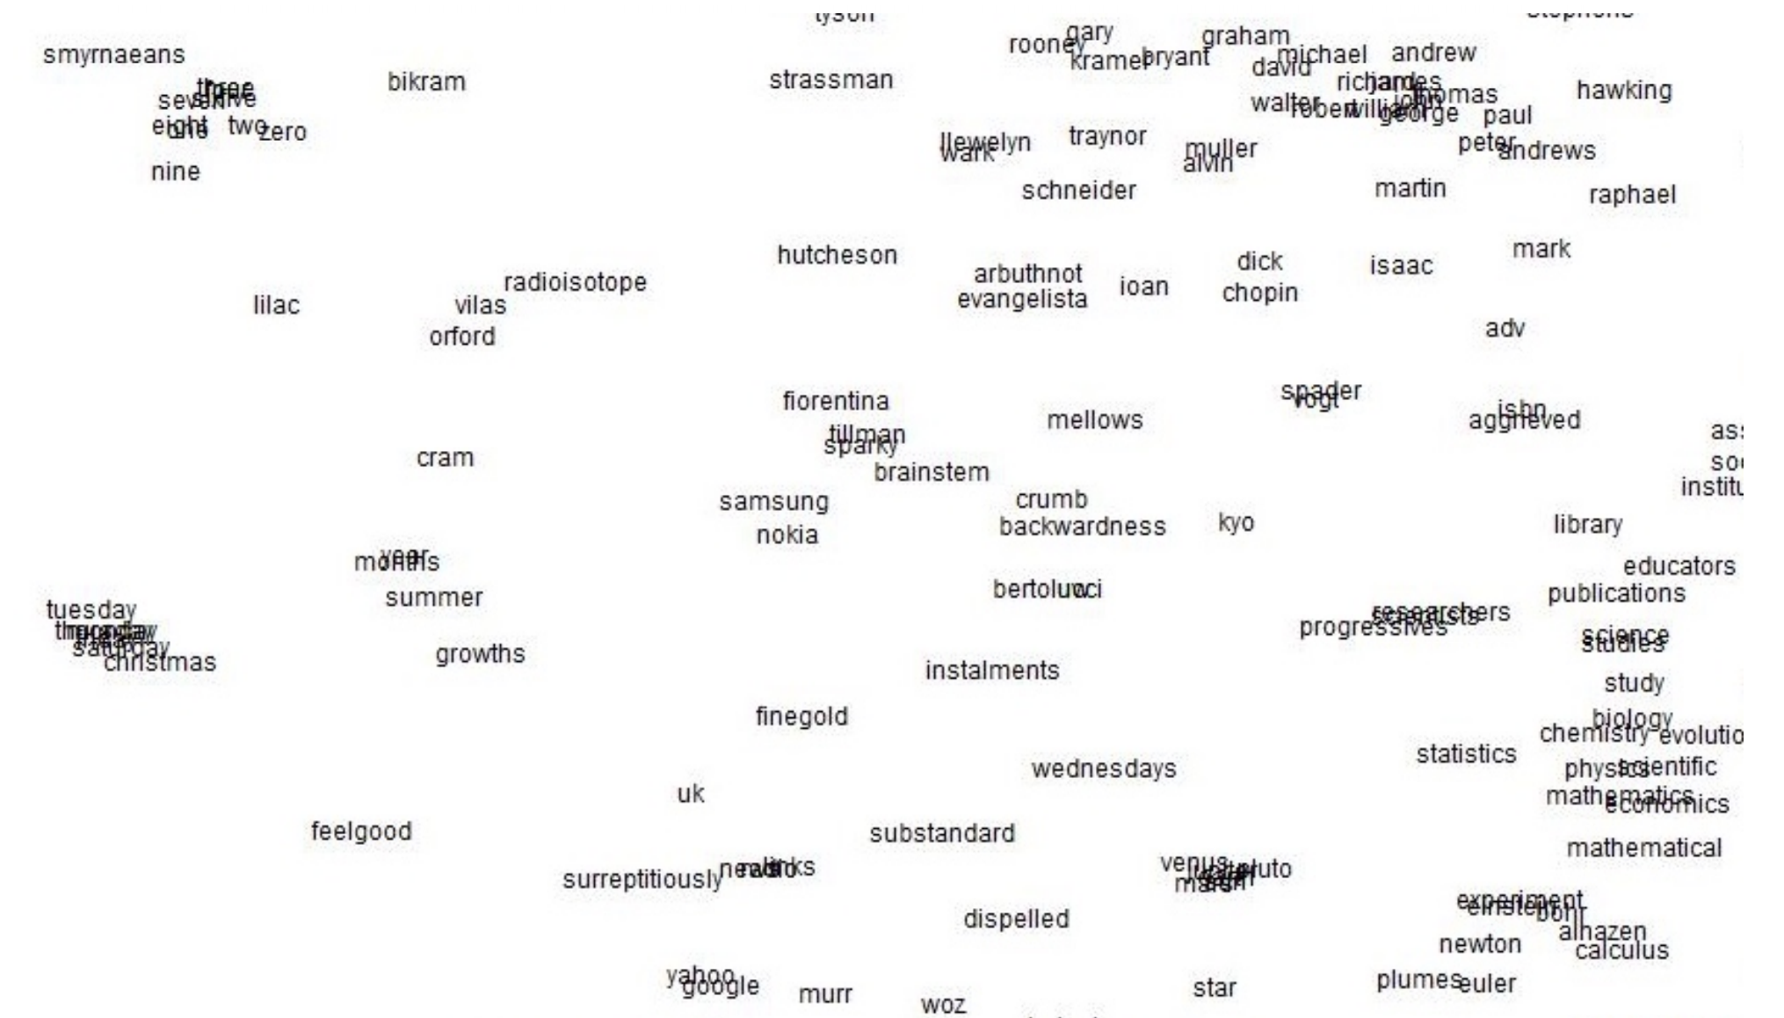
http://web.stanford.edu/class/cs224n/slides/cs224n-2019-lecture02-wordvecs2.pdf

Slide 16
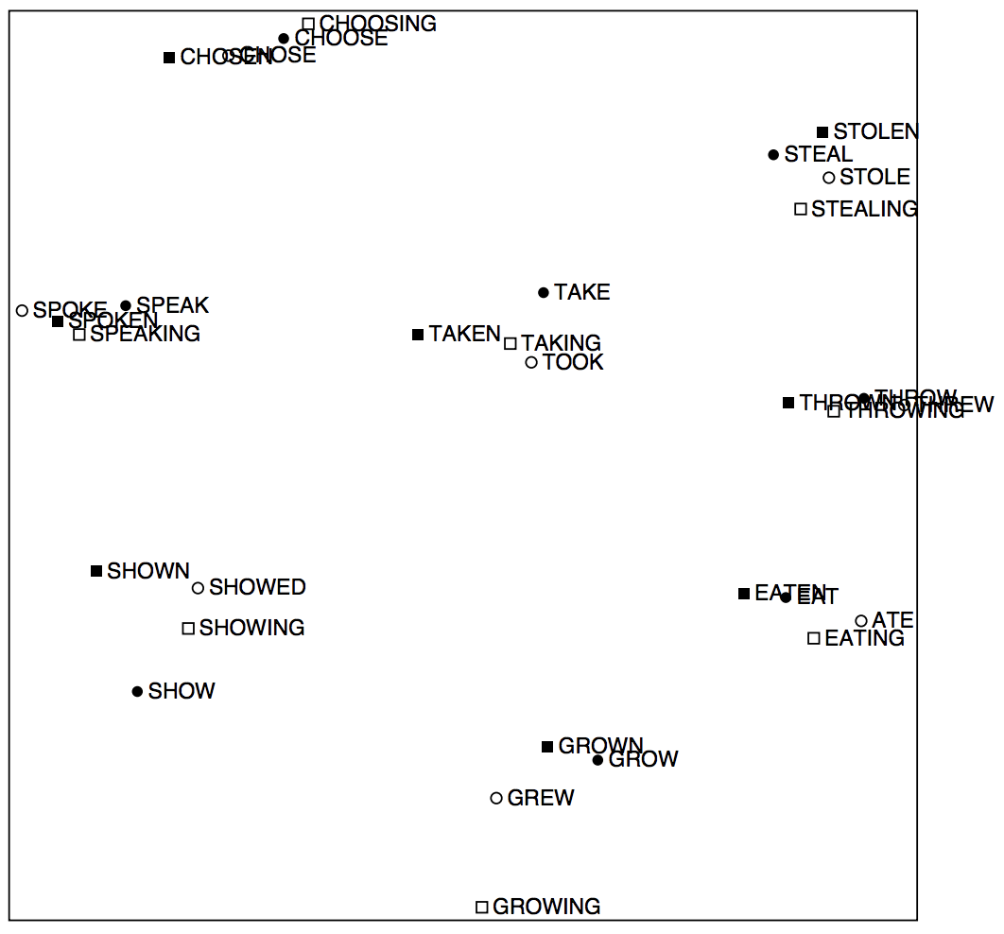
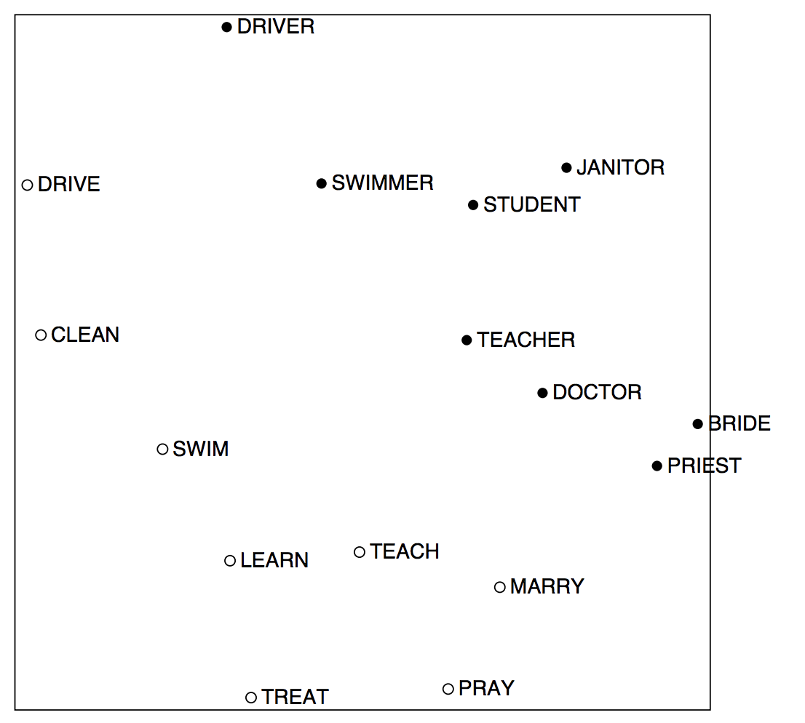
http://web.stanford.edu/class/cs224n/slides/cs224n-2019-lecture02-wordvecs2.pdf

Slide 17
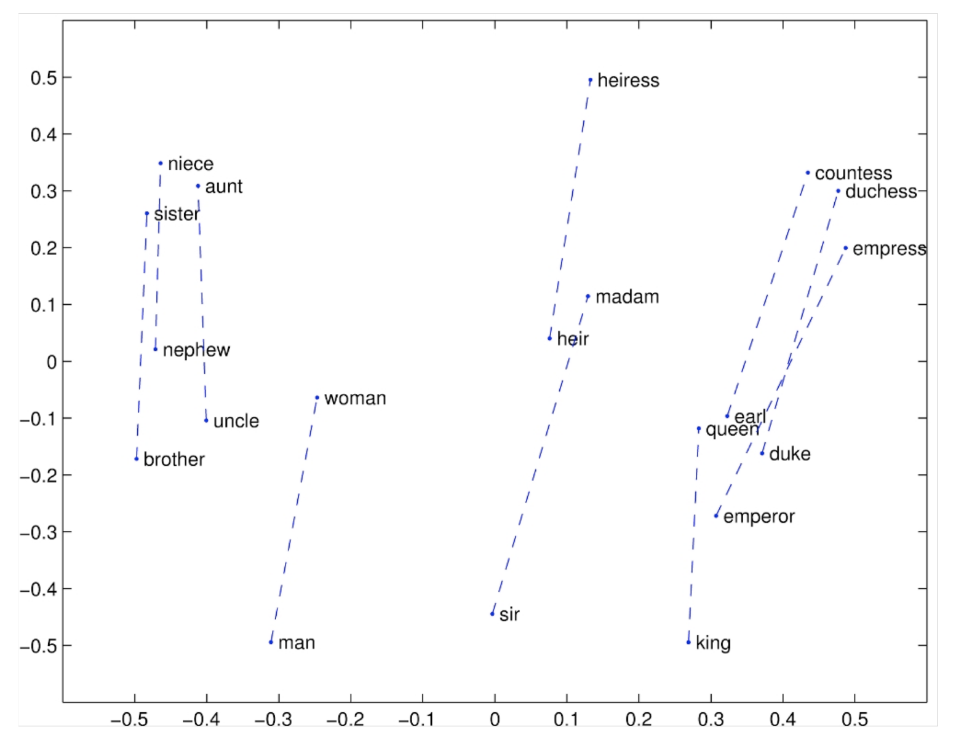
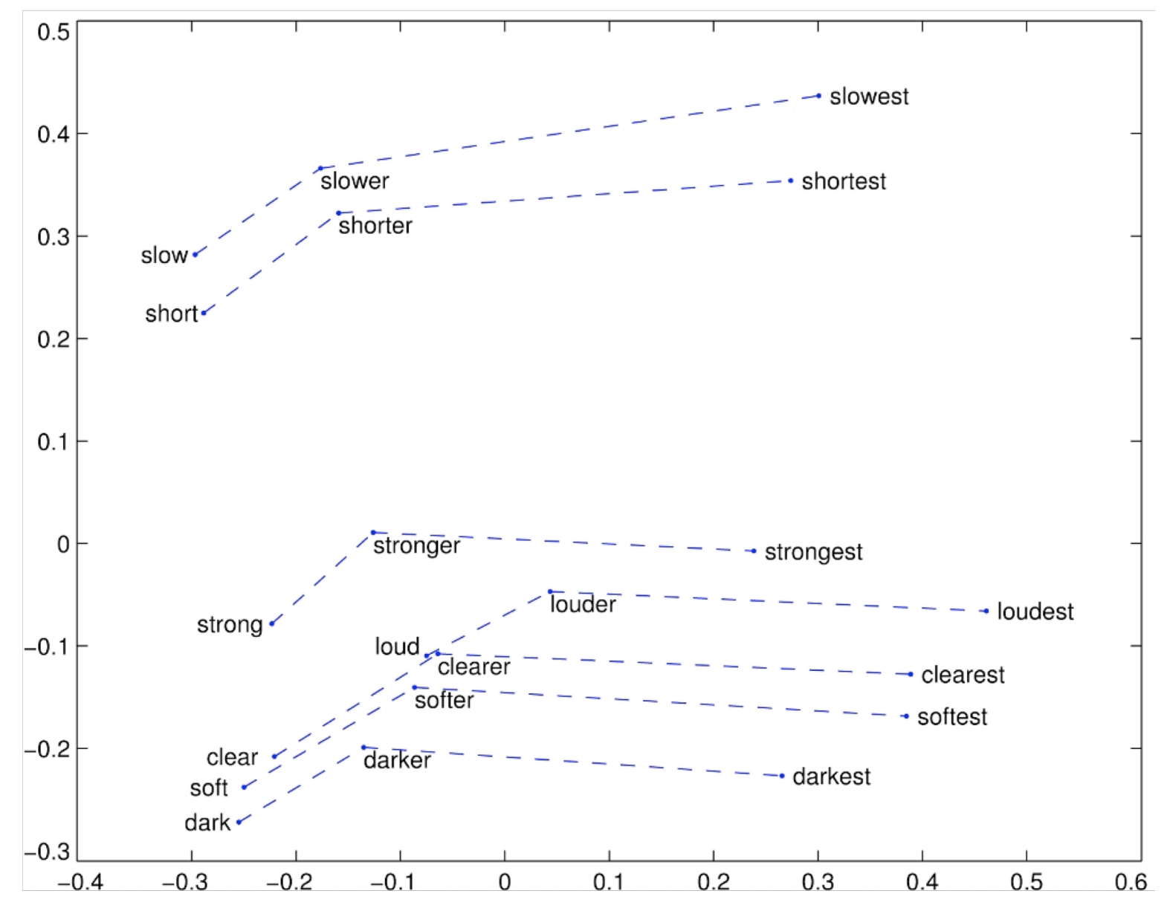
http://web.stanford.edu/class/cs224n/slides/cs224n-2019-lecture02-wordvecs2.pdf

Slide 18
Machine Learning / Deep Learning for NLP
1.1 | -1 | 0.2 | 0.7 | .. | .. | .. | .. | .. | 1.5
Class Label
Feature Vector
Model
Email
SPAM Classification
Word2Vec
Spam / Not Spam
Vector for each word
1.1 | -1 | 0.2 | 0.7 | .. | .. | .. | .. | .. | 1.5
Model (Let’s discuss this now)

Slide 19
Recurrent Neural Networks
We still have a LIST of word vectors – one vector for each word
If the email is 100 words long, we have 100 vectors
If the email is 200 words long, we have 200 vectors
Model data sequences
Daily stock prices
Text is a sequence of words!

Slide 20
Recurrent Neural Networks
Encodes “I liked”
Encodes “I liked this”
Hidden Vectors
h4
W_{h}
W_{h}
W_{h}
h1
h2
h3
Classify
W_{x}
W_{x}
W_{x}
W_{x}
Encodes “I liked this movie”
Word Vectors
I
liked
this
movie

Slide 21
Recurrent Neural Networks
h_{i} = f(h_{i-1} , x_{i} )
hi-1
Hidden Vectors
hi
hn
h1
W_{h}
W_{h}
W_{h}
W_{h}
W_{h}
h2
…
…
W_{x}
W_{x}
W_{x}
W_{x}
Word Vectors
x1
x2
xi
xn

Slide 22
Material adapted from
http://web.stanford.edu/class/cs224n/slides/cs224n-2019-lecture06-rnnlm.pdf
http://web.stanford.edu/class/cs224n/slides/cs224n-2019-lecture01-wordvecs1.pdf
http://web.stanford.edu/class/cs224n/slides/cs224n-2019-lecture02-wordvecs2.pdf
http://www.cs.jhu.edu/~jason/465/PowerPoint/lect01-intro.ppt

Slide 23
Questions?

